Slide 1
ME: 7268 Turbulent Flows
Class Project
February 27, 2025

Slide 2
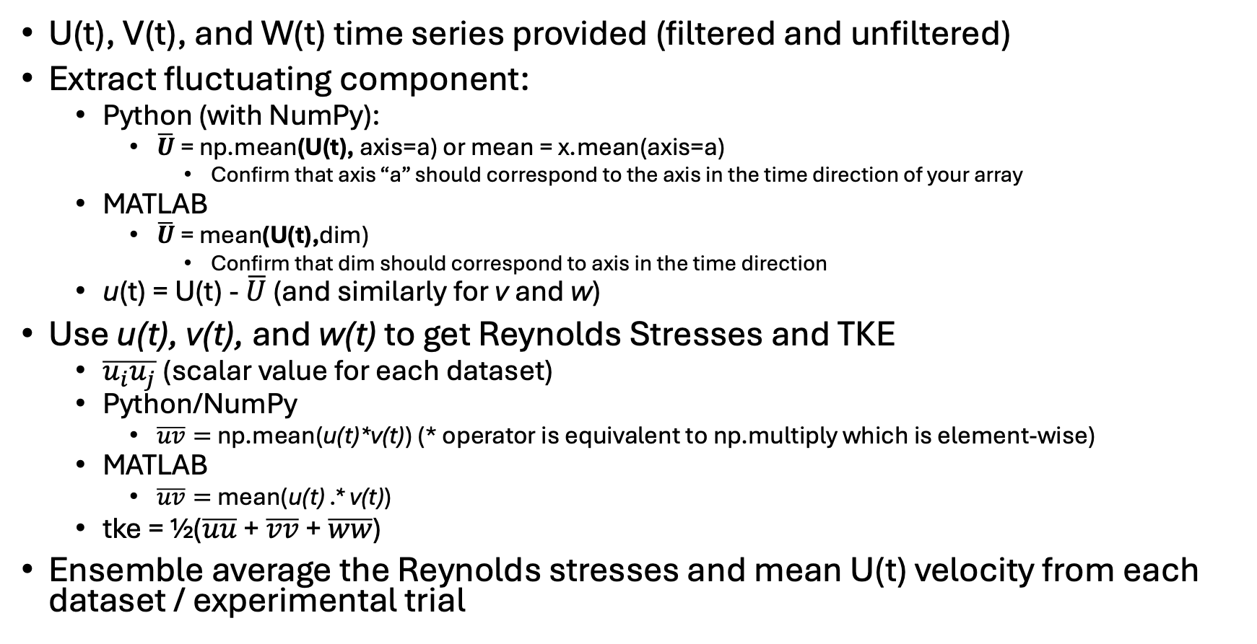
Velocity Statistic Analysis
U(t), V(t), and W(t) time series provided (filtered and unfiltered)
Extract fluctuating component:
  Python (with NumPy):
    $\overline{U}$ = np.mean(U(t), axis=a) or mean = x.mean(axis=a)
      Confirm that axis “a” should correspond to the axis in the time direction of your array
  MATLAB
    $\overline{U}$ = mean(U(t),dim)
      Confirm that dim should correspond to axis in the time direction
  u(t) = U(t) - $\overline{U}$ (and similarly for v and w)
Use u(t), v(t), and w(t) to get Reynolds Stresses and TKE
  $\overline{u_{i}u_{j}}$(scalar value for each dataset)
  Python/NumPy
    $\overline{uv}=$ np.mean(u(t)*v(t)) (* operator is equivalent to np.multiply which is element-wise)
  MATLAB
    $\overline{uv}=$ mean(u(t) .* v(t))
  tke = ½($\overline{uu}$ + $\overline{vv}$ + $\overline{ww}$)
Ensemble average the Reynolds stresses and mean U(t) velocity from each dataset / experimental trial

Slide 3
Autocorrelations
Python
  SciPy or statsmodels libraries would be good choice
    correlate() or acf() function names
    Both have “direct” or “fft” method options
    Both only return the resulting correlation function (need to compute the time lag vector)
MATLAB
  autocorr()
  Will return correlation function and lags
acf (python) and autocorr (MATLAB) also allow you specify number of lags to use
  Use length of time series for the nlags argument

Slide 4
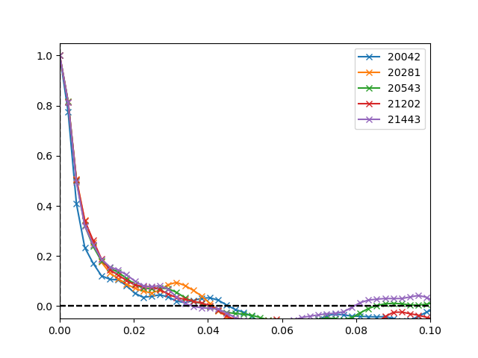
Autocorrelation (cont.)
Ensemble the autocorrelation functions together
  Use np.mean (Python) or mean (MATLAB) functions
  adjust axis or dim argument appropriately
Use first 2* points to fit a parabola
  “mirror” the point at τ₁ across y-axis
  Use points at τ₋₁ , τ₀ , τ₁ with:
    np.polyfit (python)
    polyfit (MATLAB)
    Use n = 2 (second order polynomial)
  Both function will return coefficients for a parabola
Use coefficients to plot the parabolic fit and determine τ_{E} (Taylor micro scale)
  Can use “roots” function from NumPy or MATLAB or use Eqn. from instructions with 2nd derivative of R_{E} (should be equivalent)
R_{E}
τ
Autocorrelation Functions of SDVP vortex core at x/L = 0.12

Slide 5
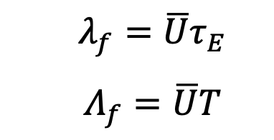
Autocorrelation (cont.)
Determine the zero-crossing (ZC) point of the R_{E}
  Integrate R_{E} from 0 to ZC point to determine T (Taylor macro scale)
  SciPy and MATLAB should have functions you can use to do this
    Trapezoidal or Simpson’s rule numerical integration methods recommended
      Not sure MATLAB has a built-in Simpson’s rule integration function
Convert T and τ_{E} from time scales to length scales with Taylor’s frozen turbulence hypothesis (TFTH)
  Use ensembled mean velocity from earlier statistics analysis

Slide 6
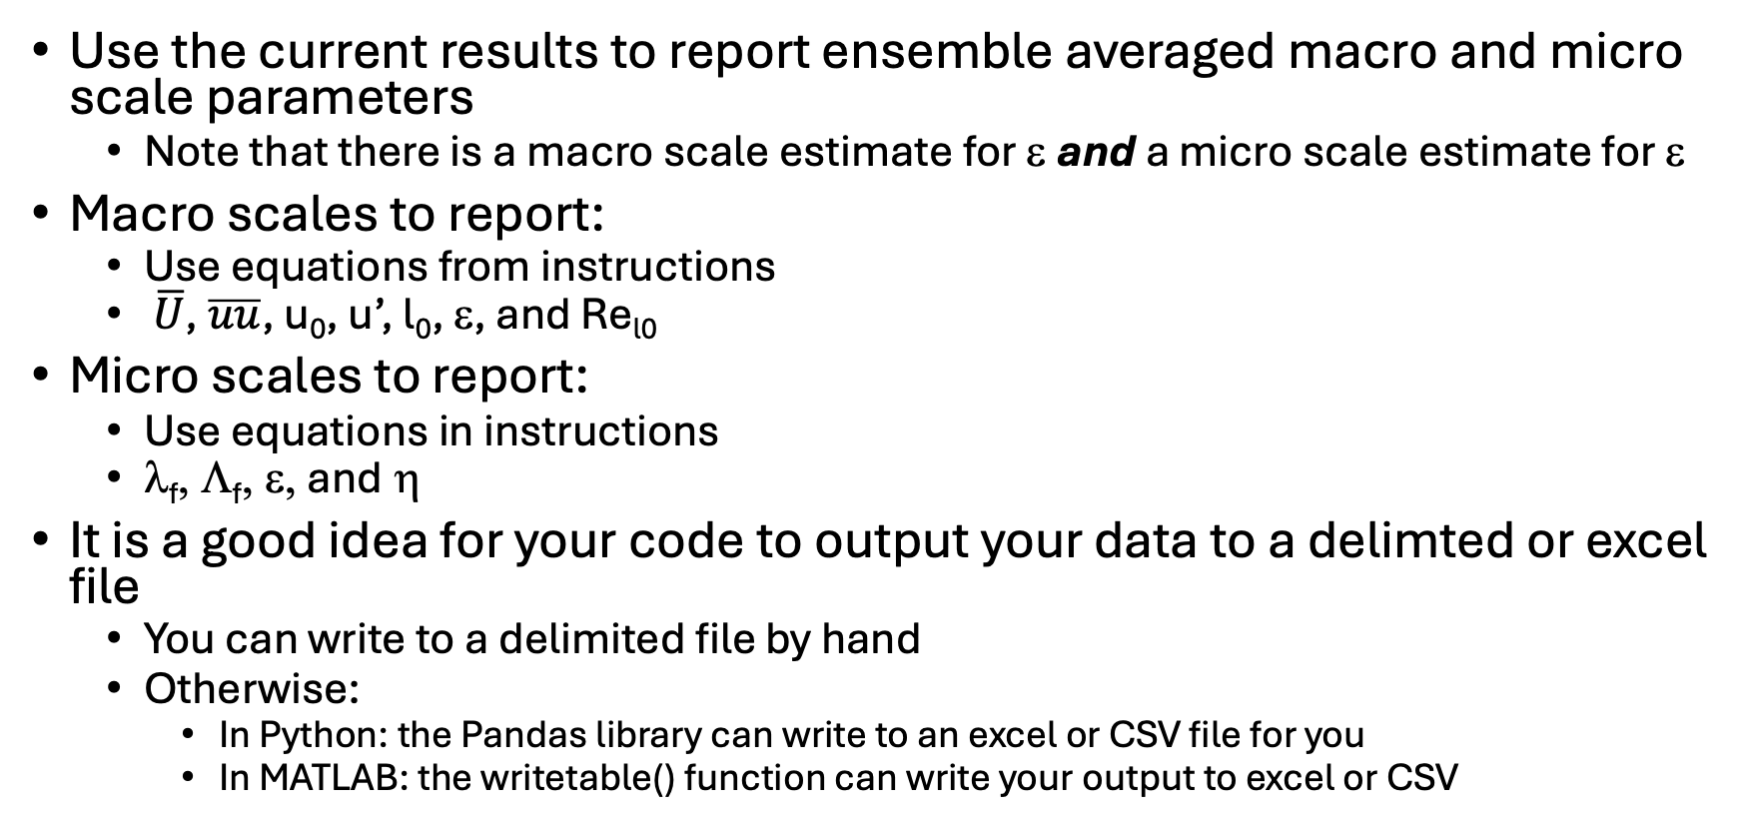
Report macro and micro scales
Use the current results to report ensemble averaged macro and micro scale parameters
  Note that there is a macro scale estimate for ε and a micro scale estimate for ε
Macro scales to report:
  Use equations from instructions
  $\overline{U}$, $\overline{uu}$, u₀, u’, l₀, ε, and Re_{l0}
Micro scales to report:
  Use equations in instructions
  λ_{f}, Λ_{f}, ε, and η
It is a good idea for your code to output your data to a delimted or excel file
  You can write to a delimited file by hand
  Otherwise:
    In Python: the Pandas library can write to an excel or CSV file for you
    In MATLAB: the writetable() function can write your output to excel or CSV

Slide 7
1D Energy Spectrum
MATLAB and SciPy have fft functions that can be used to get E₁₁ spectrum in the frequency domain
  You can take FFT of R_{E} or using the power spectral density (PSD)/convolution approach on u(t)
  Both methods are given in the instructions
  Windowing functions may need to be used (more details to come)
However, we likely will provide you with an fft function to use to ensure consistency and proper scaling of the output between everyone’s results

Slide 8
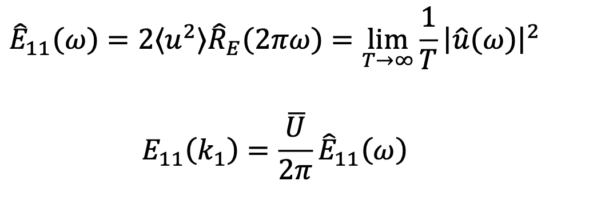
Analyzing E₁₁
First, convert E₁₁ from the frequency domain wavenumber space (k₁) with TFTH as per instructions:
Plot (and save) E₁₁ spectra for unscaled (freq. domain, wavenumber domain), Kolmogorov scaling, and compensated scaling (using both log-linear and linear-log axes)
  Scaling are included in the instructions

