Slide 1
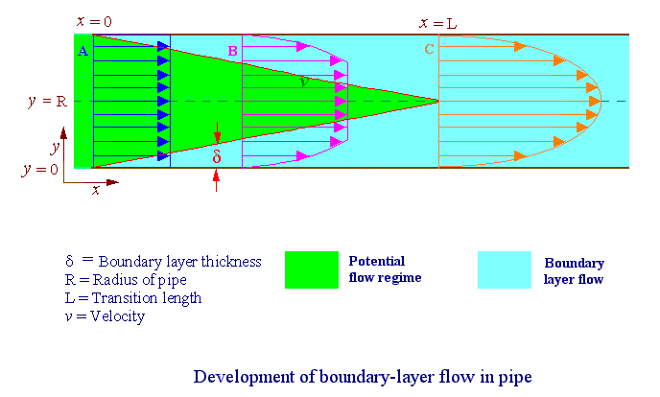
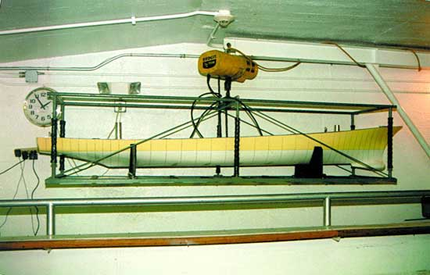
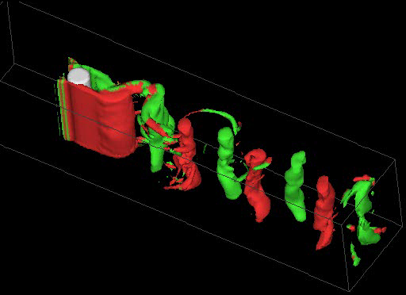
Introduction to Fluid Mechanics*
Fred Stern, Tao Xing, Jun Shao, Surajeet Ghosh
8/26/2005
AFD
EFD
CFD

Slide 2
Fluid Mechanics
Fluids essential to life
Human body 65% water
Earth’s surface is 2/3 water
Atmosphere extends 17km above the earth’s surface
History shaped by fluid mechanics
Geomorphology
Human migration and civilization
Modern scientific and mathematical theories and methods
Warfare
Affects every part of our lives

Slide 3
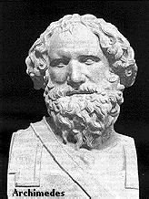
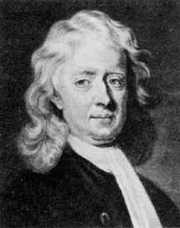
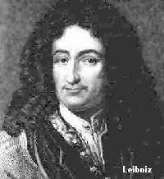
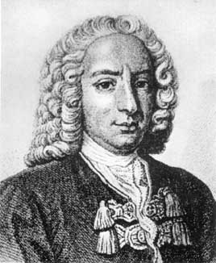
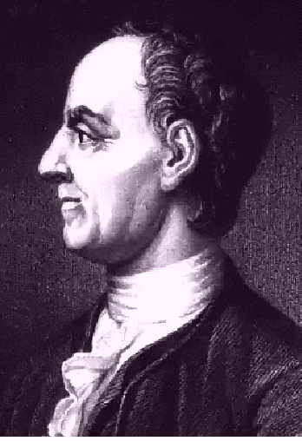
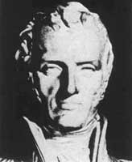
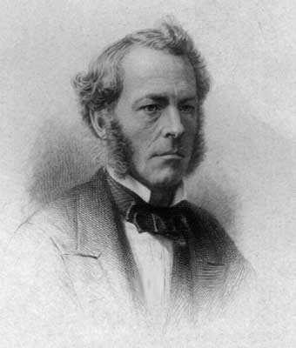
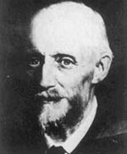
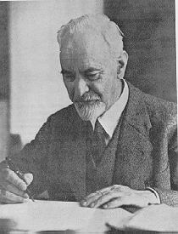
History
Faces of Fluid Mechanics
Archimedes
(C. 287-212 BC)
Newton
(1642-1727)
Leibniz
(1646-1716)
Bernoulli
(1667-1748)
Euler
(1707-1783)
Navier
(1785-1836)
Stokes
(1819-1903)
Reynolds
(1842-1912)
Prandtl
(1875-1953)
Taylor
(1886-1975)

Slide 4
Significance
Fluids omnipresent
Weather & climate
Vehicles: automobiles, trains, ships, and planes, etc.
Environment
Physiology and medicine
Sports & recreation
Many other examples!

Slide 5
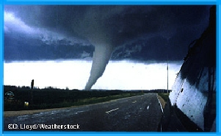
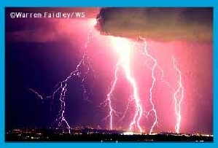
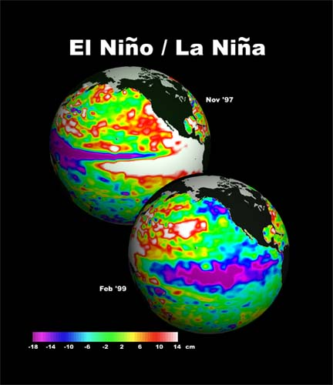
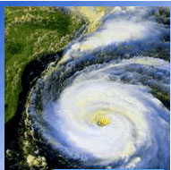
Weather & Climate
Tornadoes
Thunderstorm
Global Climate
Hurricanes

Slide 6
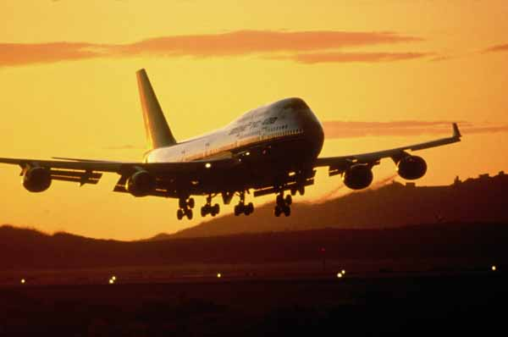
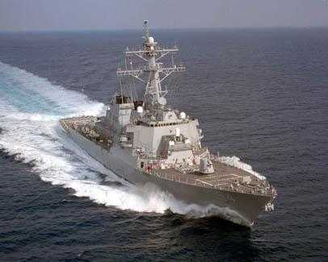
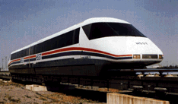
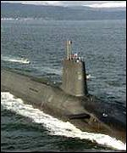
Vehicles
Aircraft
Surface ships
High-speed rail
Submarines

Slide 7
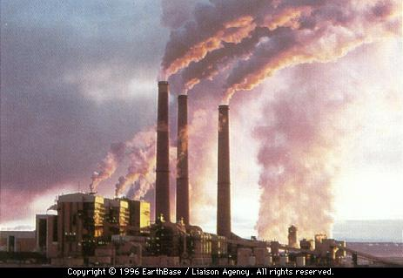
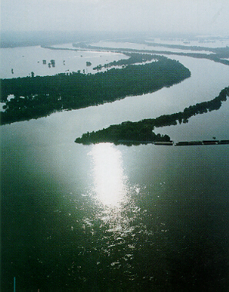
Environment
Air pollution
River hydraulics

Slide 8
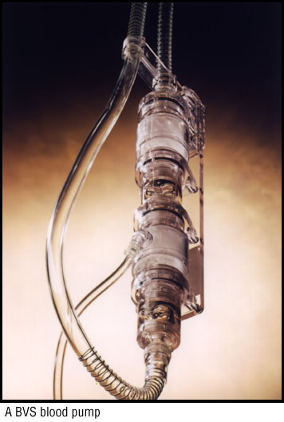
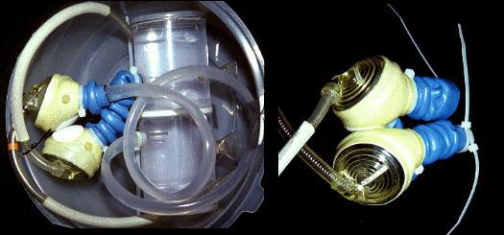
Physiology and Medicine
Blood pump
Ventricular assist device

Slide 9
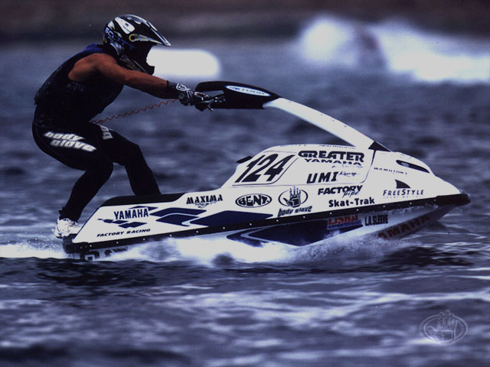
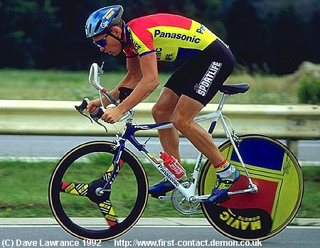
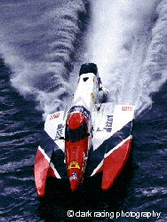
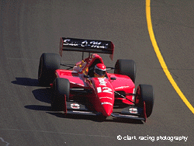
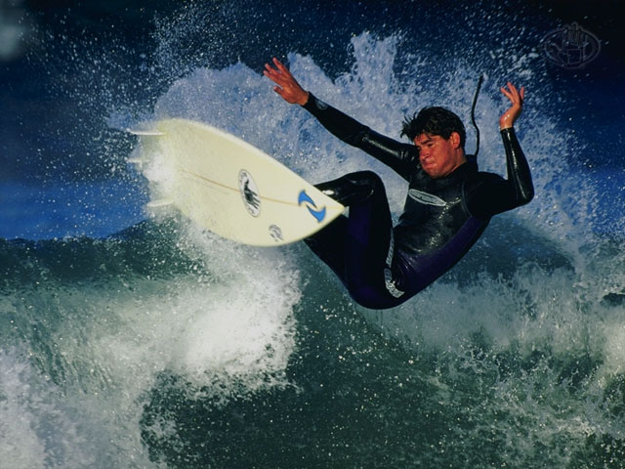
Sports & Recreation
Water sports
Cycling
Offshore racing
Auto racing
Surfing

Slide 10
Fluids Engineering
Reality
Fluids Engineering System
Components
Idealized
EFD,
Mathematical Physics Problem Formulation
AFD,
CFD,

Slide 11
Analytical Fluid Dynamics
The theory of mathematical physics problem formulation
Control volume & differential analysis
Exact solutions only exist for simple geometry and conditions
Approximate solutions for practical applications
Linear
Empirical relations using EFD data

Slide 12
Analytical Fluid Dynamics
Lecture Part of Fluid Class
Definition and fluids properties
Fluid statics
Fluids in motion
Continuity, momentum, and energy principles
Dimensional analysis and similitude
Surface resistance
Flow in conduits
Drag and lift

Slide 13
Analytical Fluid Dynamics
Example: laminar pipe flow
Assumptions: Fully developed, Low
Approach: Simplify momentum equation, integrate, apply boundary conditions to determine integration constants and use energy equation to calculate head loss
Schematic
0
0
0
Exact solution :
Friction factor:
Head loss:

Slide 14
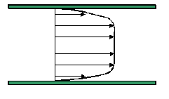
Analytical Fluid Dynamics
Example: turbulent flow in smooth pipe( )
Three layer concept (using dimensional analysis)
Laminar sub-layer (viscous shear dominates)
Overlap layer (viscous and turbulent shear important)
3. Outer layer (turbulent shear dominates)
(k=0.41, B=5.5)
Assume log-law is valid across entire pipe:
Integration for average velocity and using EFD data to adjust constants:

Slide 15
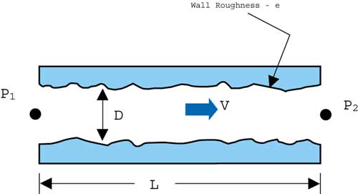
Analytical Fluid Dynamics
Example: turbulent flow in rough pipe
Both laminar sublayer and overlap layer
are affected by roughness
Inner layer:
Outer layer: unaffected
Overlap layer:
constant
Three regimes of flow depending on k⁺
K⁺<5, hydraulically smooth (no effect of roughness)
5 < K⁺< 70, transitional roughness (Re dependent)
K⁺> 70, fully rough (independent Re)
For 3, using EFD data to adjust constants:
Friction factor:

Slide 16
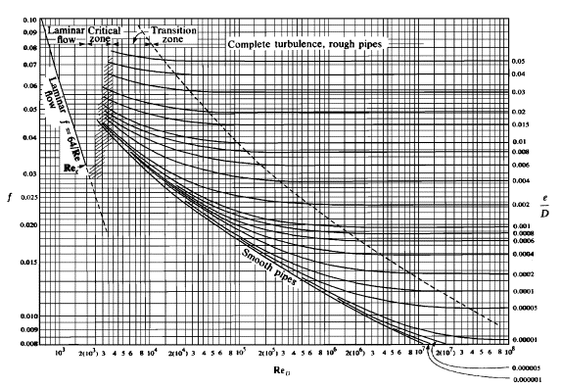
Analytical Fluid Dynamics
Example: Moody diagram for turbulent pipe flow
Composite Log-Law for smooth and rough pipes is given by the Moody diagram:

Slide 17
Experimental Fluid Dynamics (EFD)
Definition:
Use of experimental methodology and procedures for solving fluids engineering systems, including full and model scales, large and table top facilities, measurement systems (instrumentation, data acquisition and data reduction), uncertainty analysis, and dimensional analysis and similarity.
EFD philosophy:
Decisions on conducting experiments are governed by the ability of the expected test outcome, to achieve the test objectives within allowable uncertainties.
Integration of UA into all test phases should be a key part of entire experimental program
test design
determination of error sources
estimation of uncertainty
documentation of the results

Slide 18
Purpose
Science & Technology: understand and investigate a phenomenon/process, substantiate and validate a theory (hypothesis)
Research & Development: document a process/system, provide benchmark data (standard procedures, validations), calibrate instruments, equipment, and facilities
Industry: design optimization and analysis, provide data for direct use, product liability, and acceptance
Teaching: instruction/demonstration

Slide 19
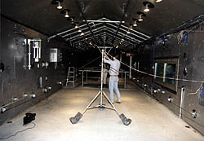
Applications of EFD
Application in science & technology
Picture of Karman vortex shedding
Application in research & development
Tropic Wind Tunnel has the ability to create
temperatures ranging from 0 to 165 degrees
Fahrenheit and simulate rain

Slide 20
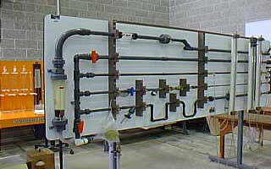
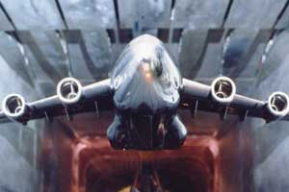
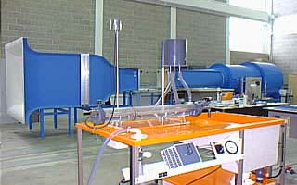
Applications of EFD (cont’d)
Example of industrial application
NASA's cryogenic wind tunnel simulates flight
conditions for scale models--a critical tool in
designing airplanes.
Application in teaching
Fluid dynamics laboratory

Slide 21
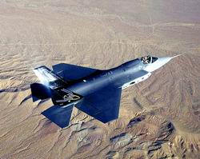
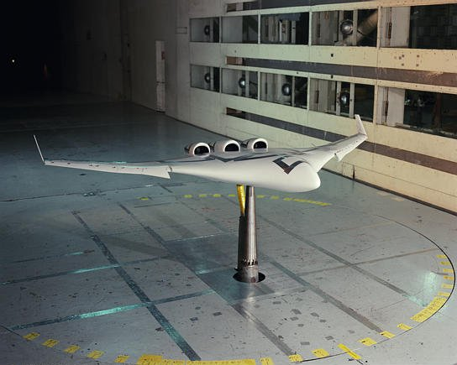
Full and model scale
Scales: model, and full-scale
Selection of the model scale: governed by dimensional analysis and similarity

Slide 22
Measurement systems
Instrumentation
Load cell to measure forces and moments
Pressure transducers
Pitot tubes
Hotwire anemometry
PIV, LDV
Data acquisition
Serial port devices
Desktop PC’s
Plug-in data acquisition boards
Data Acquisition software - Labview
Data analysis and data reduction
Data reduction equations
Spectral analysis

Slide 23
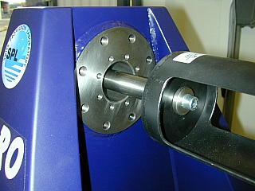
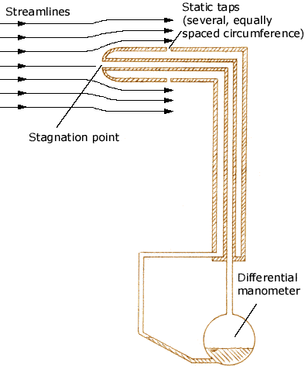
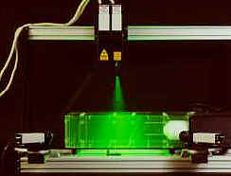
Instrumentation
Pitot tube
Load cell
Hotwire
3D - PIV

Slide 24
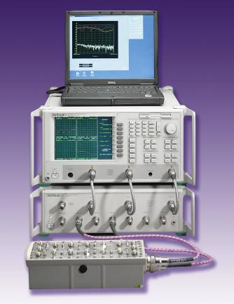
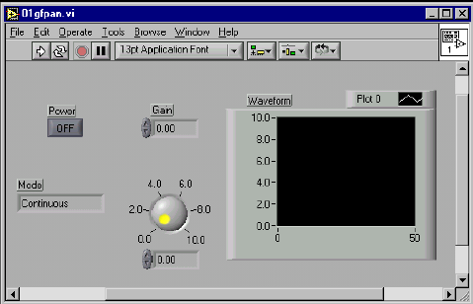
Data acquisition system
Hardware
Software - Labview

Slide 25
Data reduction methods
Data reduction equations
Spectral analysis
Example of data reduction equations

Slide 26
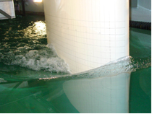
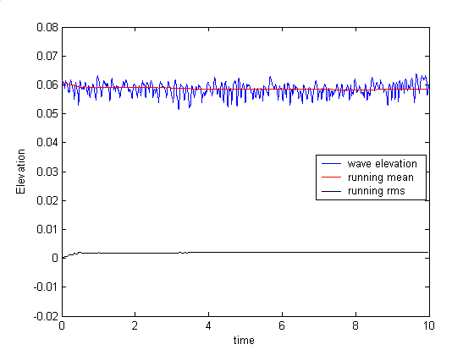
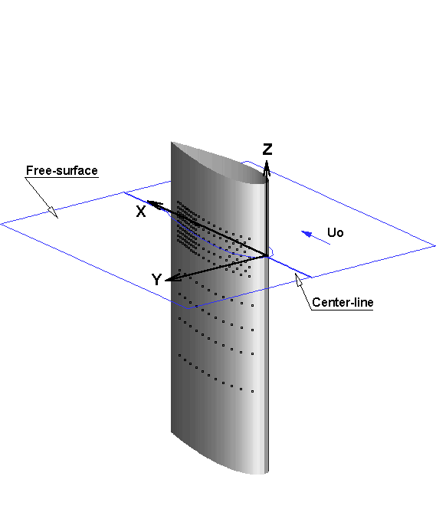
Spectral analysis
Aim: To analyze the natural unsteadiness of the separated flow, around a surface piercing
strut, using FFT.
FFT: Converts a function from amplitude as function
of time to amplitude as function of frequency
Fast Fourier Transform
Free-surface wave elevation contours
Time history of wave elevation
Surface piercing strut
FFT of wave elevation
Power spectral density
of wave elevation

Slide 27
Uncertainty analysis
Rigorous methodology for uncertainty assessment using statistical and engineering concepts

Slide 28
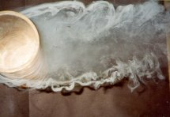
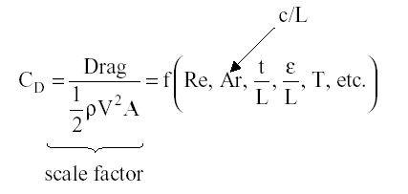
Dimensional analysis
Definition : Dimensional analysis is a process of formulating fluid mechanics problems in
in terms of non-dimensional variables and parameters.
Why is it used :
Reduction in variables ( If F(A1, A2, … , An) = 0, then f(Π1, Π2, … Πr < n) = 0,
where, F = functional form, Ai = dimensional variables, Πj = non-dimensional
parameters, m = number of important dimensions, n = number of dimensional variables, r
= n – m ). Thereby the number of experiments required to determine f vs. F is reduced.
Helps in understanding physics
Useful in data analysis and modeling
Enables scaling of different physical dimensions and fluid properties
Example
Drag = f(V, L, r, m, c, t, e, T, etc.)
From dimensional analysis,
Vortex shedding behind cylinder
Examples of dimensionless quantities : Reynolds number, Froude
Number, Strouhal number, Euler number, etc.

Slide 29
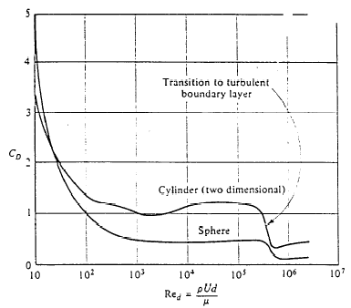
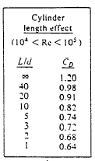
Similarity and model testing
Definition : Flow conditions for a model test are completely similar if all relevant dimensionless parameters have the same corresponding values for model and prototype.
Πi model = Πi prototype i = 1
Enables extrapolation from model to full scale
However, complete similarity usually not possible. Therefore, often it is necessary to
use Re, or Fr, or Ma scaling, i.e., select most important Π and accommodate others
as best possible.
Types of similarity:
Geometric Similarity : all body dimensions in all three coordinates have the same
linear-scale ratios.
Kinematic Similarity : homologous (same relative position) particles lie at homologous
points at homologous times.
Dynamic Similarity : in addition to the requirements for kinematic similarity the model
and prototype forces must be in a constant ratio.

Slide 30
EFD process
“EFD process” is the steps to set up an experiment and
take data

Slide 31
EFD – “hands on” experience
Lab1: Measurement of density and
kinematic viscosity of a fluid
Lab2: Measurement of
flow rate, friction factor and
velocity profiles in smooth and
rough pipes.
Lab3: Measurement of surface pressure
Distribution, lift and drag coefficient for an airfoil

Slide 32
Computational Fluid Dynamics
CFD is use of computational methods for solving fluid engineering systems, including modeling (mathematical & Physics) and numerical methods (solvers, finite differences, and grid generations, etc.).
Rapid growth in CFD technology since advent of computer
ENIAC 1, 1946
IBM WorkStation

Slide 33
Purpose
The objective of CFD is to model the continuous fluids with Partial Differential Equations (PDEs) and discretize PDEs into an algebra problem, solve it, validate it and achieve simulation based design instead of “build & test”
Simulation of physical fluid phenomena that are difficult to be measured by experiments: scale simulations (full-scale ships, airplanes), hazards (explosions,radiations,pollution), physics (weather prediction, planetary boundary layer, stellar evolution).

Slide 34
Modeling
Mathematical physics problem formulation of fluid engineering system
Governing equations: Navier-Stokes equations (momentum), continuity equation, pressure Poisson equation, energy equation, ideal gas law, combustions (chemical reaction equation), multi-phase flows(e.g. Rayleigh equation), and turbulent models (RANS, LES, DES).
Coordinates: Cartesian, cylindrical and spherical coordinates result in different form of governing equations
Initial conditions(initial guess of the solution) and Boundary Conditions (no-slip wall, free-surface, zero-gradient, symmetry, velocity/pressure inlet/outlet)
Flow conditions: Geometry approximation, domain, Reynolds Number, and Mach Number, etc.

Slide 35
Modeling (examples)
Developing flame surface (Bell et al., 2001)
Free surface animation for ship in regular waves
Evolution of a 2D mixing layer laden with particles of Stokes
Number 0.3 with respect to the vortex time scale (C.Narayanan)

Slide 36
Modeling (examples, cont’d)
3D vortex shedding behind a circular cylinder (Re=100,DNS,J.Dijkstra)
DES, Re=10⁵, Iso-surface of Q criterion (0.4) for turbulent flow around NACA12 with angle of attack 60 degrees
LES of a turbulent jet. Back wall shows a slice of the dissipation rate and the bottom wall shows a carpet plot of the mixture fraction in a slice through the jet centerline, Re=21,000 (D. Glaze).

Slide 37
Numerical methods
y
Finite difference methods: using numerical scheme to approximate the exact derivatives in the PDEs
Finite volume methods
Grid generation: conformal mapping, algebraic methods and differential equation methods
Grid types: structured, unstructured
Solvers: direct methods (Cramer’s rule, Gauss elimination, LU decomposition) and iterative methods (Jacobi, Gauss-Seidel, SOR)
jmax
j+1
j
j-1
o
i-1
i
i+1
imax
x
Slice of 3D mesh of a fighter aircraft

Slide 38
CFD process
Geometry
Physics
Mesh
Solve
Reports
Post-Processing
Select Geometry
Heat Transfer ON/OFF
Unstructured
(automatic/
manual)
Steady/
Unsteady
Forces Report
(lift/drag, shear stress, etc)
Contours
Geometry Parameters
Compressible
ON/OFF
Structured
(automatic/
manual)
Iterations/
Steps
XY Plot
Vectors
Domain Shape and Size
Flow properties
Convergent Limit
Verification
Streamlines
Viscous Model
Precisions
(single/
double)
Validation
Boundary Conditions
Numerical Scheme
Initial Conditions

Slide 39
Commercial software
CFD software
1. FLUENT: http://www.fluent.com
2. FLOWLAB: http://www.flowlab.fluent.com
3. CFDRC: http://www.cfdrc.com
4. STAR-CD: http://www.cd-adapco.com
5. CFX/AEA: http://www.software.aeat.com/cfx
Grid Generation software
1. Gridgen: http://www.pointwise.com
2. GridPro: http://www.gridpro.com
Visualization software
1. Tecplot: http://www.amtec.com
2. Fieldview: http://www.ilight.com

Slide 40
“Hands-on” experience using CFD Educational Interface (pipe template)

Slide 41
“Hands-on” experience using CFD Educational Interface (airfoil template)

Slide 42
57:020 Fluid Mechanics
Lectures cover basic concepts in fluid statics, kinematics, and dynamics, control-volume, and differential-equation analysis methods. Homework assignments, tests, and complementary EFD/CFD labs
This class provides an introduction to all three tools: AFD through lecture and CFD and EFD through labs
ISTUE Teaching Modules (http://www.iihr.uiowa.edu/~istue) (next two slides)

Slide 43
TM Descriptions
Table 1: ISTUE Teaching Modules for Introductory Level Fluid Mechanics at Iowa
Teaching Modules
TM for Fluid Property
TM for Pipe Flow
TM for Airfoil Flow
Overall Purpose
Hands-on student experience with table-top facility and simple MS for fluid property measurement, including comparison manufacturer values and rigorous implementation standard EFD UA
Hands-on student experience with complementary EFD, CFD, and UA for Introductory Pipe Flow, including friction factor and mean velocity measurements and comparisons benchmark data, laminar and turbulent flow CFD simulations, modeling and verification studies, and validation using AFD and EFD.
Hands-on student experience with complementary EFD, CFD, and UA for Introductory Airfoil Flow, including lift and drag, surface pressure, and mean and turbulent wake velocity profile measurements and comparisons benchmark data, inviscid and turbulent flow simulations, modeling and verification studies, and validation using AFD and EFD.
Educational Materials
FM and EFD lecture; lab report instructions; pre lab questions, and EFD exercise notes.
FM, EFD and CFD lectures; lab report instructions; pre lab questions, and EFD and CFD exercise notes.
FM, EFD and CFD lectures; lab report instructions; pre lab questions, and EFD and CFD exercise notes.
ISTUE ASEE papers
Paper 1 Paper2
FM Lecture
Introduction to Fluid Mechanics
Lab Report Instructions
EFD lab report Instructions CFD lab report Instructions
Continued in next slide…
http://css.engineering.uiowa.edu/~fluids

Slide 44
TM Descriptions, cont’d
Teaching Modules
TM for Fluid Property
TM for Pipe Flow
TM for Airfoil Flow
CFD
CFD Lecture
Introduction to CFD
Exercise Notes
None
CFD Prelab1
PreLab1 Questions
CFD Lab 1
Lab Concepts
EFD Data
CFD Prelab2
PreLab 2 Questions
CFD Lab2
Lab Concepts
EFD Data
EFD
EFD
Lecture
EFD and UA
Exercise Notes
PreLab1 Questions
Lab1 Lecture
Lab 1 exercise notes
Lab 1 data reduction sheet
Lab concepts
PreLab2 Questions
Lab2 Lecture
Lab 2 exercise notes
Lab2 Data reduction sheet (smooth & rough)
Lab concepts
PreLab3 Questions
Lab3 Lecture
Lab 3 exercise notes
Data Reduction Sheet
Lab concepts
UA(EFD)
Lecture
EFD UA Report
Exercise Notes
Instructions UA
UA(CFD)
Lecture
Exercise Notes
None

