Slide 1
Grid Generation and Post-Processing for Computational Fluid Dynamics (CFD)
Maysam Mousaviraad, Tao Xing and Fred Stern
IIHR—Hydroscience & Engineering
C. Maxwell Stanley Hydraulics Laboratory
The University of Iowa
ME:5160 Intermediate Mechanics of Fluids
http://css.engineering.uiowa.edu/~me_160/
November 4, 2015

Slide 2
Outline
1. Introduction
2. Choice of grid
2.1. Simple geometries
2.2. Complex geometries
3. Grid generation
3.1. Conformal mapping
3.2. Algebraic methods
3.3. Differential equation methods
3.4. Commercial software
3.5. Systematic grid generation for CFD UA
4. Post-processing
4.1. UA (details in “Introduction to CFD”)
4.2. Calculation of derived variables
4.3. Calculation of integral variables
4.4. Visualization
5. References and books

Slide 3
Introduction
The numerical solution of partial differential equations requires some discretization of the field into a collection of points or elemental volumes (cells)
The differential equations are approximated by a set of algebraic equations on this collection, which can be solved to produce a set of discrete values that approximate the solution of the PDE over the field
Grid generation is the process of determining the coordinate transformation that maps the body-fitted non-uniform non-orthogonal physical space x,y,z,t into the transformed uniform orthogonal computational space, ξ,η,ζ,τ.
Post-processing is the process to examine and analyze the flow field solutions, including contours, vectors, streamlines, Iso-surfaces, animations, and CFD Uncertainty Analysis.

Slide 4
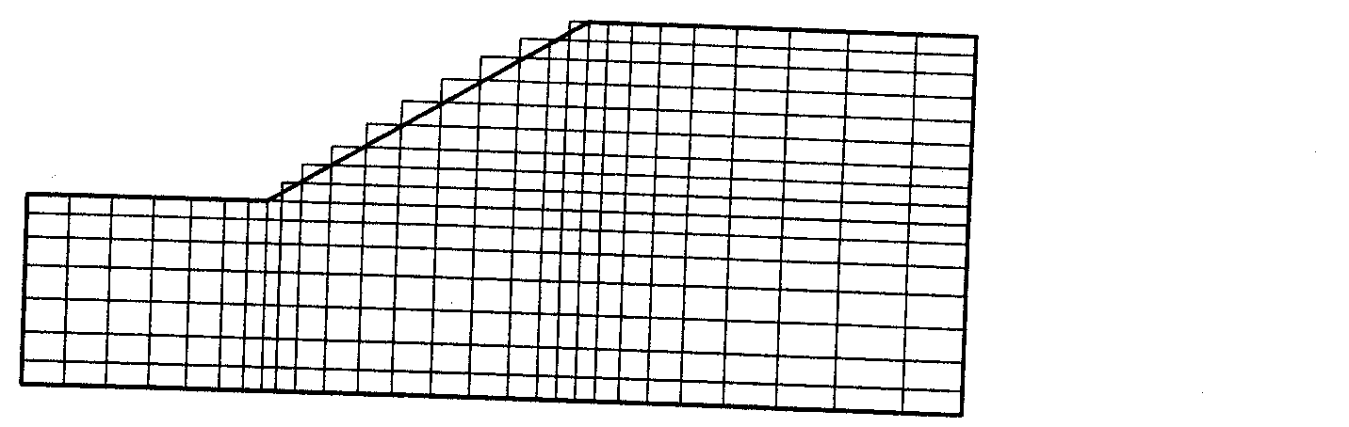
Choice of grid
Simple/regular geometries (e.g. pipe, circular cylinder): the grid lines usually follow the coordinate directions.
Complex geometries (Stepwise Approximation)
1. Using Regular Grids to approximate solution domains with inclined
or curved boundaries by staircase-like steps.
2. Problems:
(1). Number of grid points (or CVs) per grid line is not constant,
special arrays have to be created
(2). Steps at the boundary introduce errors into solutions
(3). Not recommended except local grid refinement near the
wall is possible.
An example of a grid using stepwise approximation of an Inclined boundary

Slide 5
Choice of grid, cont’d
Complex geometries (Overlapping Chimera grid)
1. Definition: Use of a set of grids to cover irregular solution domains
2. Advantages:
(1). Reduce substantially the time and efforts to generate a grid, especially for 3D configurations with increasing geometric complexity
(2). It allows – without additional difficulty – calculation of flows around moving bodies
3. Disadvantages:
(1). The programming and coupling of the grids can be
complicated
(2). Difficult to maintain conservation at the interfaces
(3). Interpolation process may introduce errors or convergence
problems if the solution exhibits strong variation near the
interface.

Slide 6
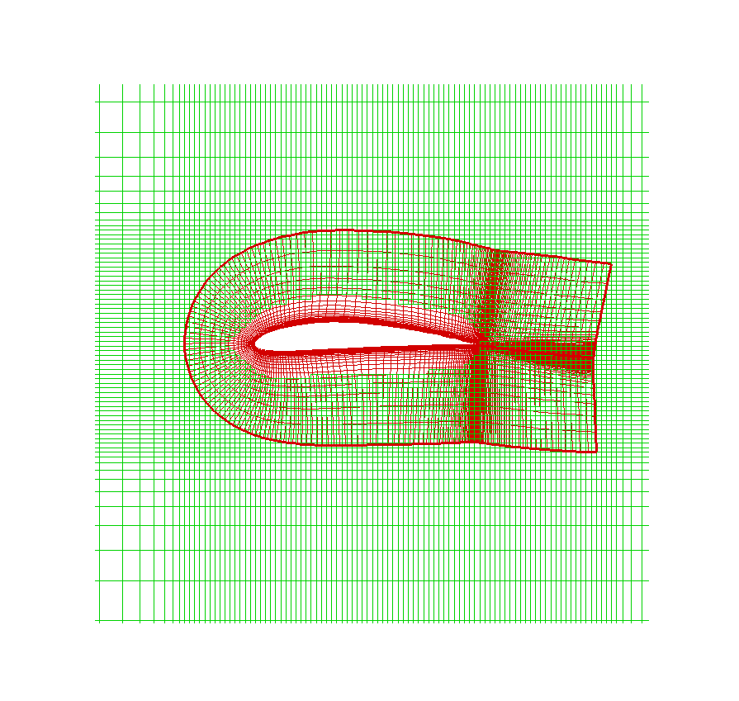
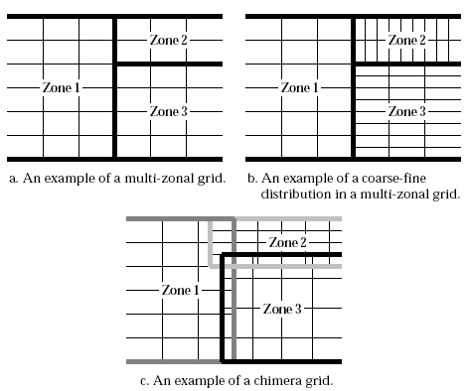
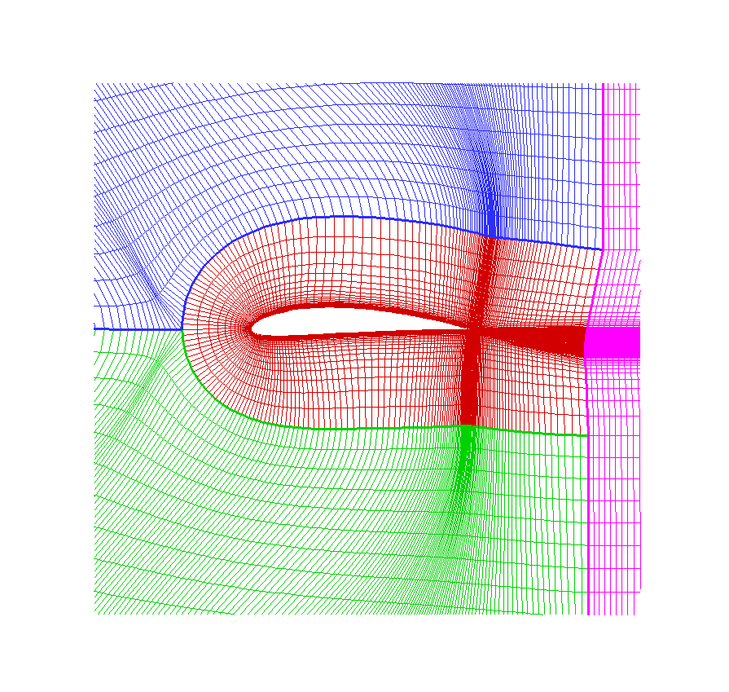
Choice of grid, cont’d
Chimera grid (examples):
CFDSHIP-IOWA
Different grid distribution approaches

Slide 7
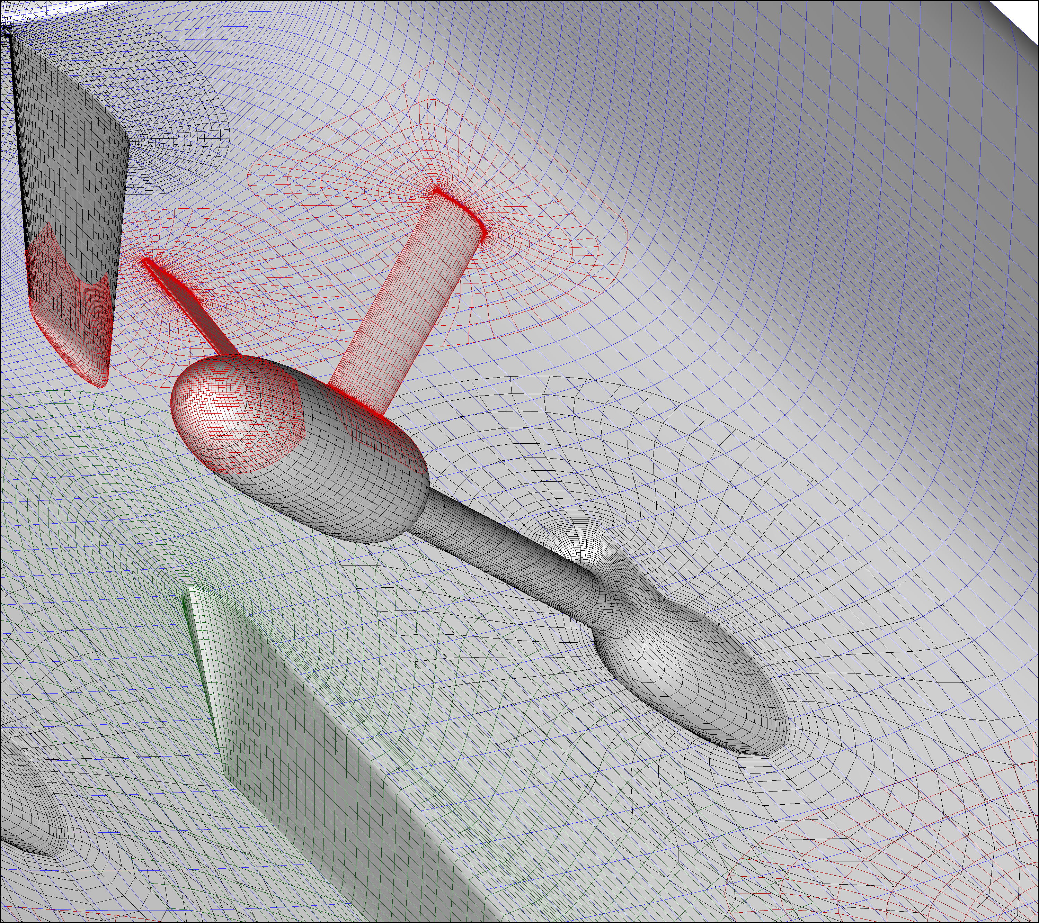
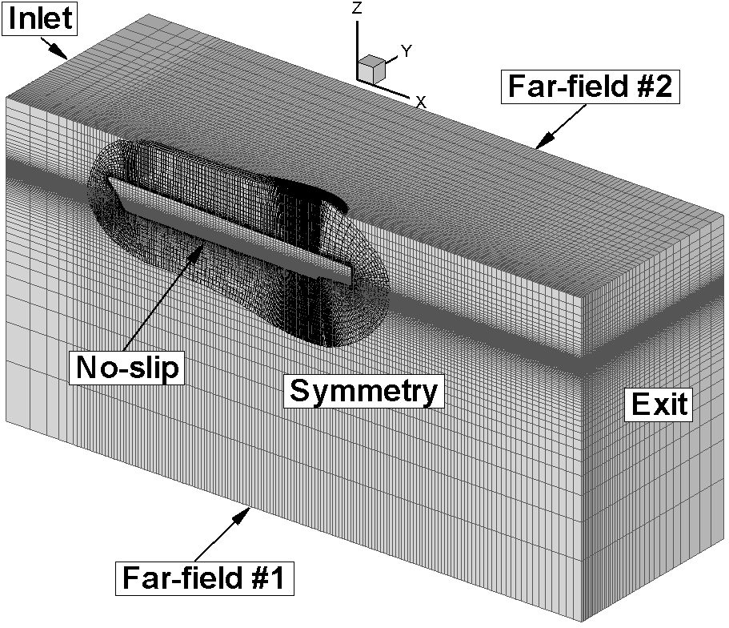
Choice of grid, cont’d
Chimera grid (examples):

Slide 8
Choice of grid, cont’d
Complex geometries (Boundary-Fitted Non-Orthogonal Grids)
1. Types:
(1). Structured
(2). Block-structured
(3). Unstructured
2. Advantages:
(1). Can be adapted to any geometry
(2). Boundary conditions are easy to apply
(3). Grid spacing can be made smaller in regions of strong variable
variation.
3. Disadvantages:
(1). The transformed equations contain more terms thereby increasing both the difficulty of programming and the cost of solving the equations
(2). The grid non-orthogonality may cause unphysical solutions.

Slide 9
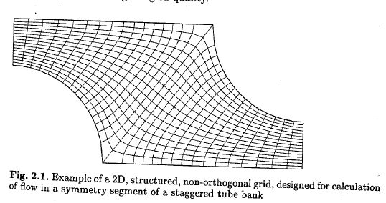
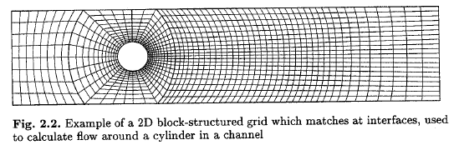
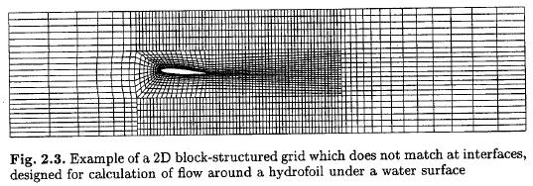
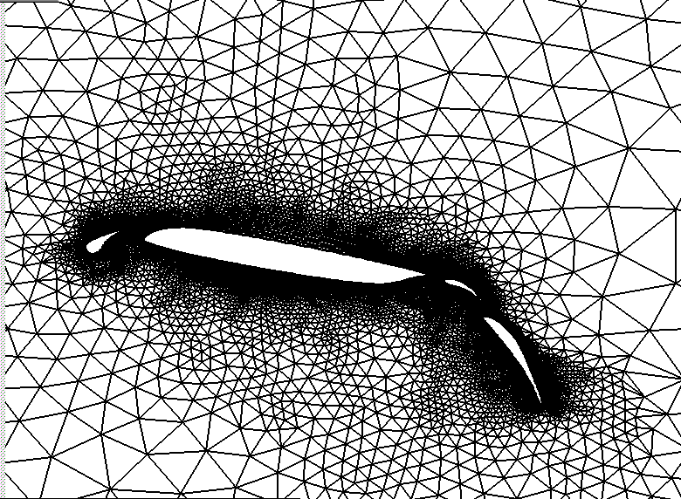
Choice of grid, cont’d
Complex geometries (Boundary-Fitted Non-Orthogonal Grids)
Block-structured
With matching interface
structured
Unstructured
Block-structured
Without matching interface

Slide 10
Grid generation
Conformal mapping: based on complex variable theory, which is limited to two dimensions.
Algebraic methods:
1. 1D: polynomials, Trigonometric functions, Logarithmic
functions
2. 2D: Orthogonal one-dimensional transformation, normalizing
transformation, connection functions
3. 3D: Stacked two-dimensional transformations, superelliptical
boundaries
Differential equation methods:
Step 1: Determine the grid point distribution on the boundaries
of the physical space.
Step 2:Assume the interior grid point is specified by a differential equation that satisfies the grid point distributions specified on the boundaries and yields an acceptable interior grid point distribution.
Commercial software (Gridgen, Gambit, etc.)

Slide 11
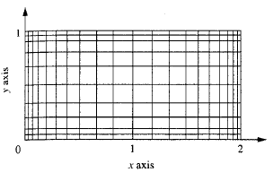
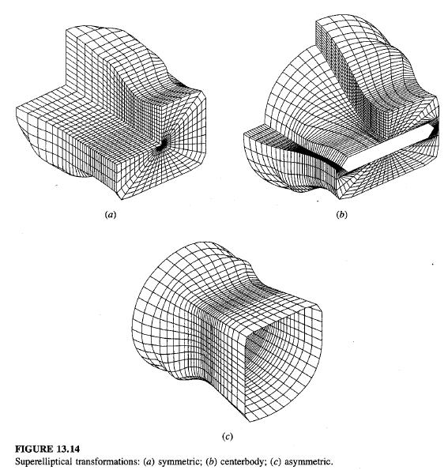
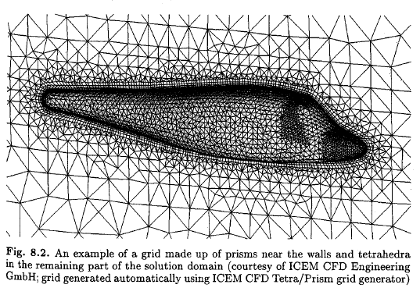
Grid generation (examples)
Orthogonal one-dimensional transformation
Superelliptical transformations: (a) symmetric; (b) centerbody; (c) asymmetric

Slide 12
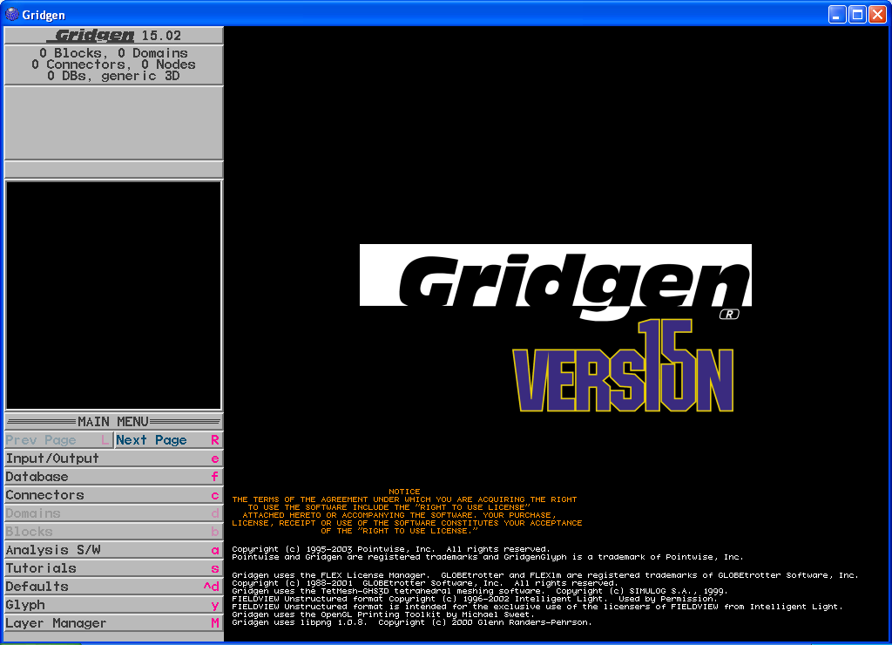
Grid generation (commercial software, gridgen)
Commercial software GRIDGEN will be used to illustrate
typical grid generation procedure

Slide 13
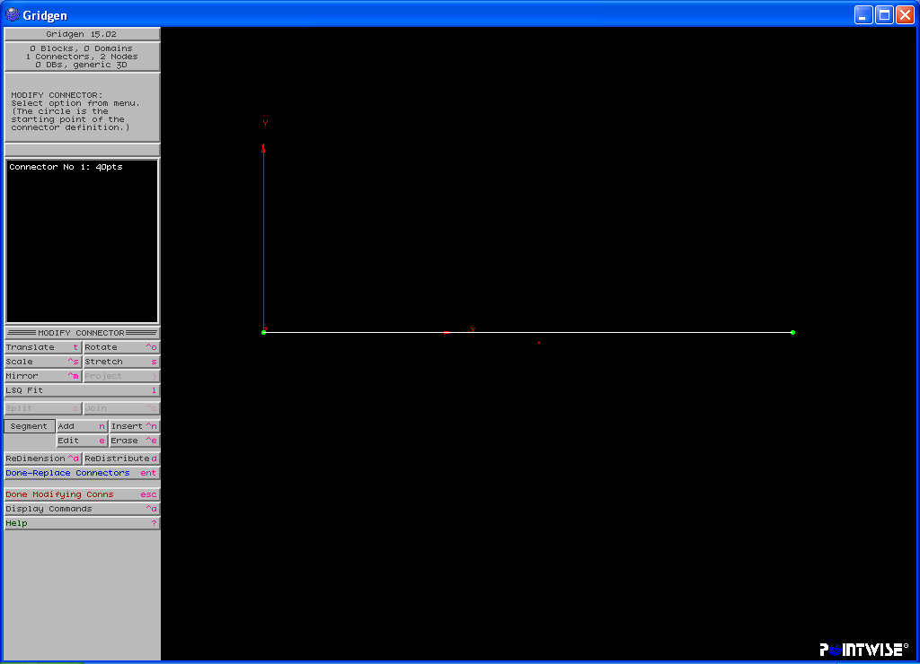
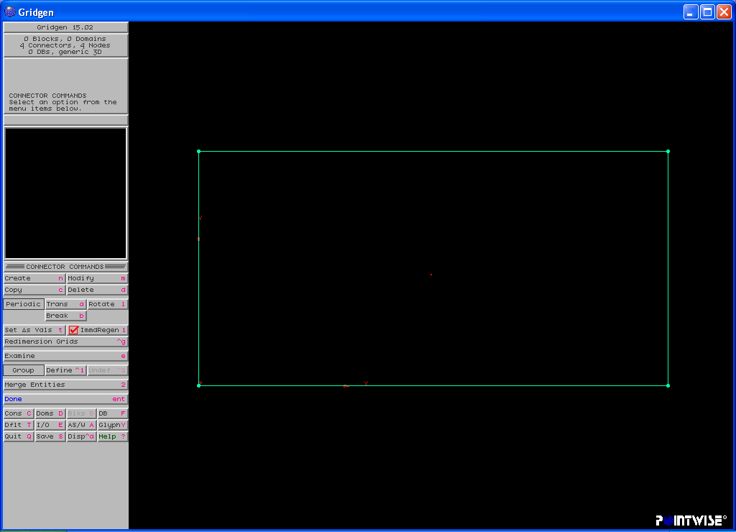
Grid generation (Gridgen, 2D pipe)
Geometry: two-dimensional axisymmetric circular pipe
Creation of connectors: “connectors”→”create”→”2 points connectors”→”input x,y,z of the two points”→”Done”.
Dimension of connectors: “Connectors”→”modify”→”Redimension”→”40”→”Done”.
(0,0.5)
(1,0.5)
C3
Repeat the procedure to create C2, C3, and C4
C4
C2
(0,0)
C1
(1,0)

Slide 14
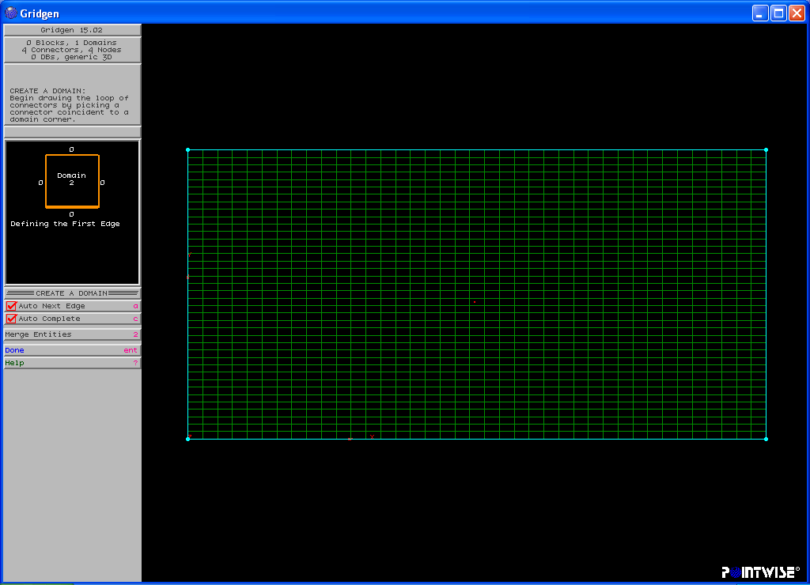
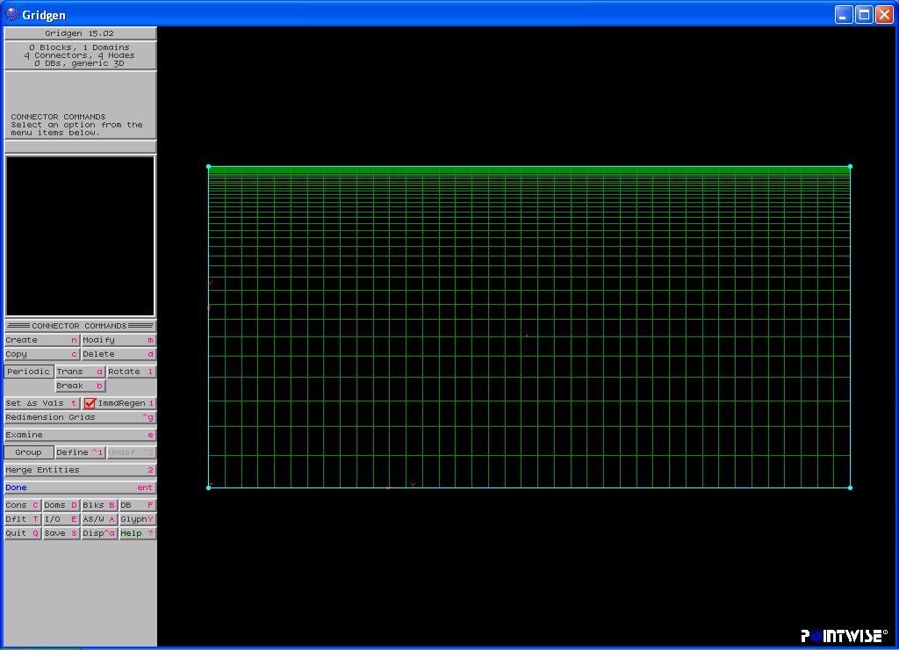
Grid generation (Gridgen, 2D pipe, cont’d)
Creation of Domain: “domain”→”create”→”structured”→”Assemble edges”→”Specify edges one by one”→”Done”.
Redistribution of grid points: Boundary layer requires grid refinement near the wall surface. “select connectors (C2, C4)”→”modify”→”redistribute”→”grid spacing(start+end)” with distribution function
For turbulent flow, the first grid spacing near the wall, i.e. “matching point”, could have different values when different turbulent models applied (near wall or wall function).
Grid may be used for laminar flow
Grid may be used for turbulent flow

Slide 15
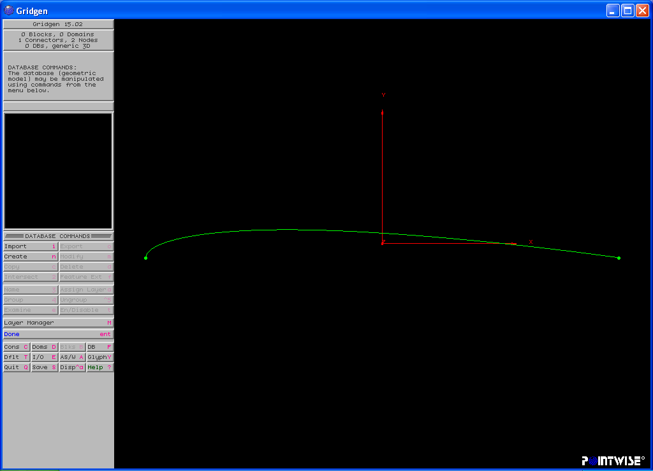
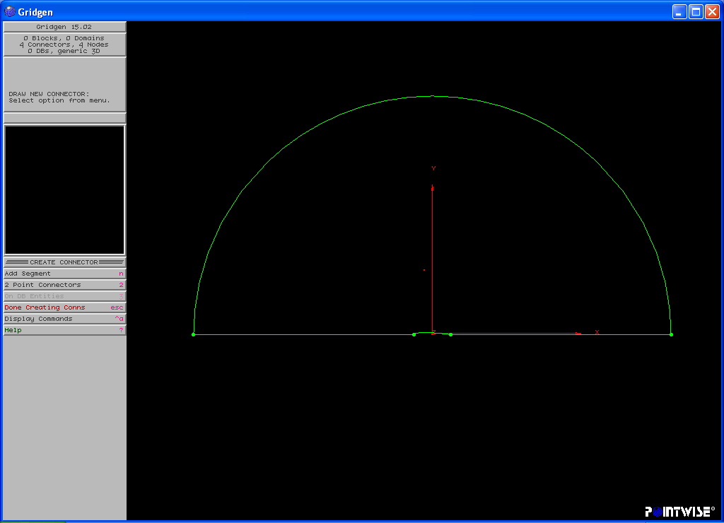
Grid generation (3D NACA12 foil)
Geometry: two-dimensional NACA12 airfoil with 60 degree angle of attack
Creation of geometry: unlike the pipe, we have to import the database for NACA12 into Gridgen and create connectors based on that (only half of the geometry shape was imported due to symmetry).
“input”→”database”→”import the geometry data”→ “connector”→”create”→”on DB entities”→”delete database”
Creation of connectors C1 (line), C2(line), C3(half circle)
Half of airfoil surface
C3
C2
C1
Half of airfoil surface

Slide 16
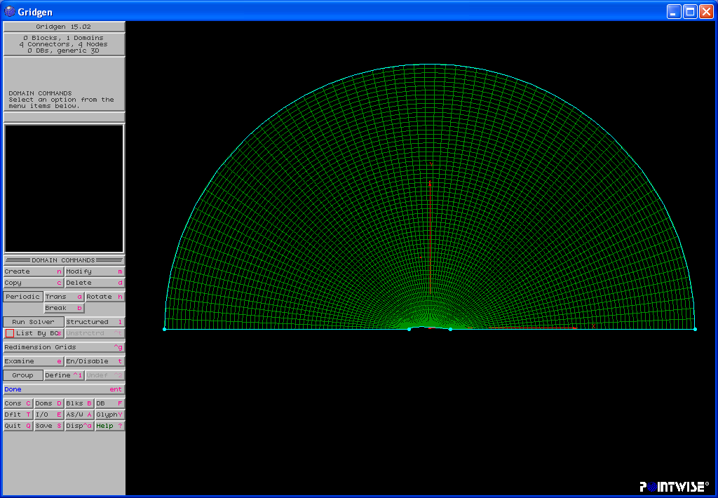
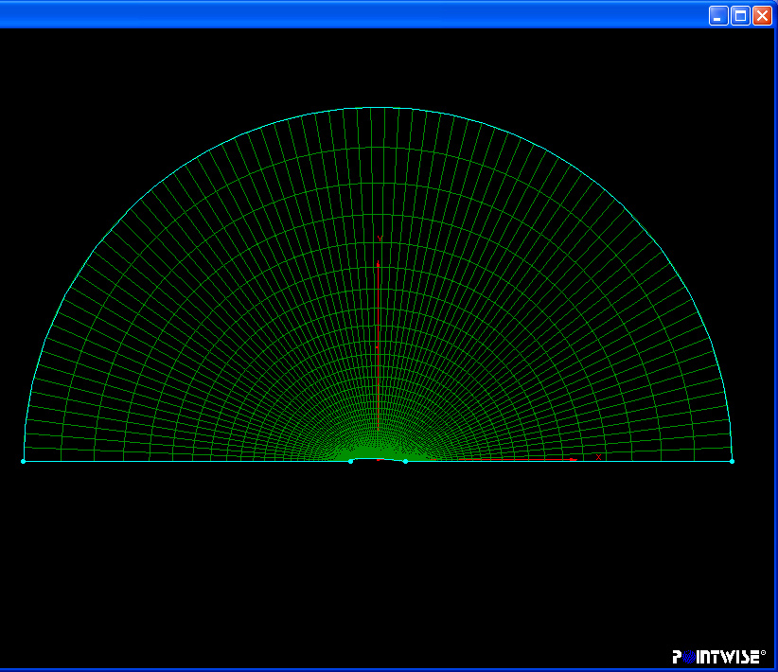
Grid generation (3D NACA12 airfoil, cont’d)
Redimensions of the four connectors and create domain
Redistribute the grid distribution for all connectors. Especially refine the grid near the airfoil surface and the leading and trailing edges

Slide 17
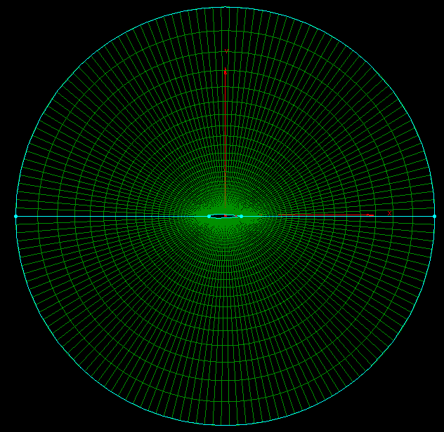
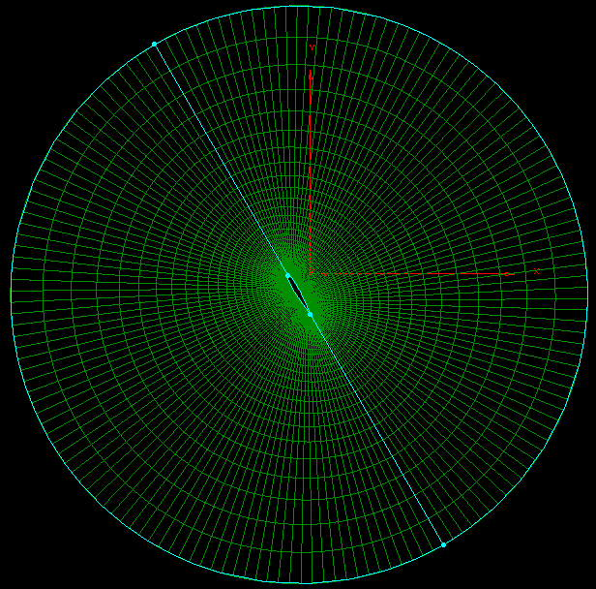
Grid generation (3D NACA12 airfoil, cont’d)
Duplicate the other half of the domain: “domain”→”modify”→”mirror respect to y=0”→”Done”.
Rotate the whole domain with angle of attack 60 degrees: “domain”→”modify”→”rotate”→”using z-principle axis”→”enter rotation angle:-60”→”Done”.

Slide 18

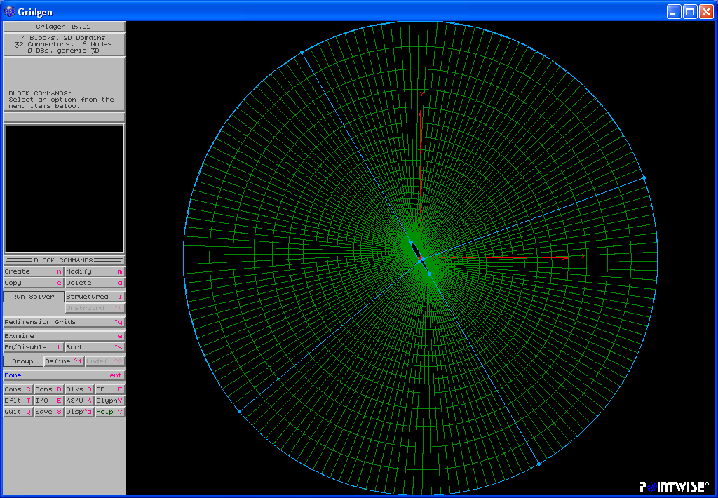
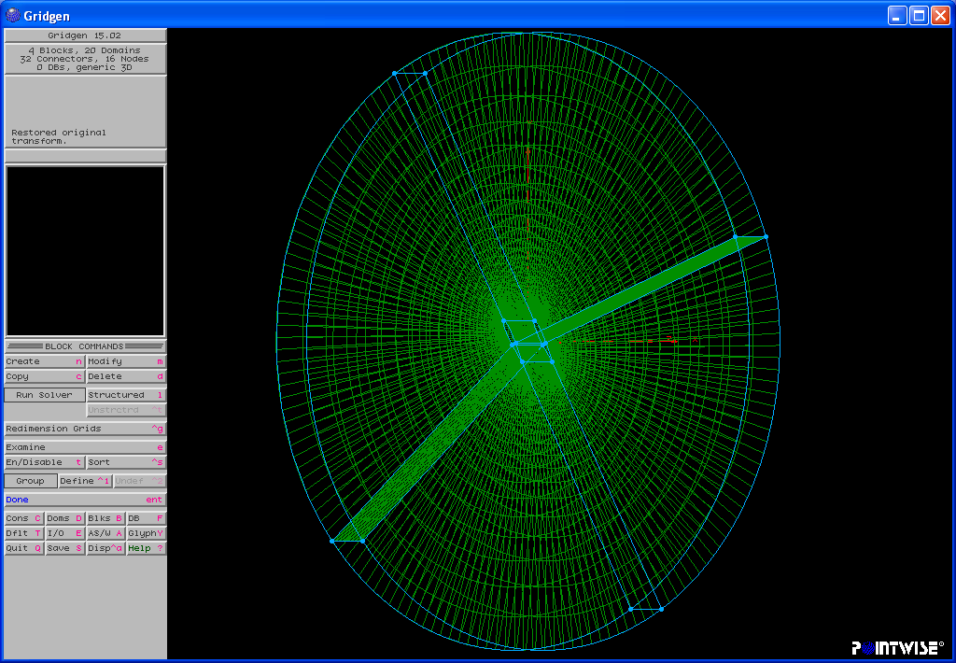
Grid generation (3D NACA12 airfoil, cont’d)
Create 3D block: “blocks”→”create”→”extrude from domains”→specify ”translate distance and direction”→”Run N”→“Done”.
Split the 3D block to be four blocks: “block”→”modify”→”split”→”in ξ direction”→” ξ =?”→”Done”.
Specify boundary conditions and export Grid and BCS.
Block 1
Block 1
Block 2
Block 2
Block 4
Block 4
Block 3
Block 3
3D before split
After split (2D view)
After split (3D view)

Slide 19
Systematic grid generation for CFD UA
CFD UA analysis requires a series of meshes with uniform grid refinement ratio, usually start from the fine mesh to generate coarser grids.
A tool is developed to automate this process, i.e., each fine grid block is input into the tool and a series of three, 1D interpolation is performed to yield a medium grid block with the desired non-integer grid refinement ratio.
1D interpolation is the same for all three directions.
Consider 1D line segment with and
points for the fine and medium grids, respectively.
step 1: compute the fine grid size at each grid node:
step 2: compute the medium grid distribution:
where from the first step is interpolated at location
step 3: The medium grid distribution is scaled so that the fine and medium grid line segments are the same (i.e., )
step4: The procedure is repeated until it converges

Slide 20
Post-Processing
Uncertainty analysis: estimate order of accuracy, correction factor, and uncertainties (for details, CFD Lecture 1, introduction to CFD).
MPI functions required to combine data from different blocks if parallel computation used
Calculation of derived variables (vorticity, shear stress)
Calculation of integral variables (forces, lift/drag coefficients)
Calculation of turbulent quantities: Reynolds stresses, energy spectra
Visualization
1. XY plots (time/iterative history of residuals and forces, wave
elevation)
2. 2D contour plots (pressure, velocity, vorticity, eddy viscosity)
3. 2D velocity vectors
4. 3D Iso-surface plots (pressure, vorticity magnitude, Q criterion)
5. Streamlines, Pathlines, streaklines
6. Animations
Other techniques: Fast Fourier Transform (FFT), Phase averaging

Slide 21
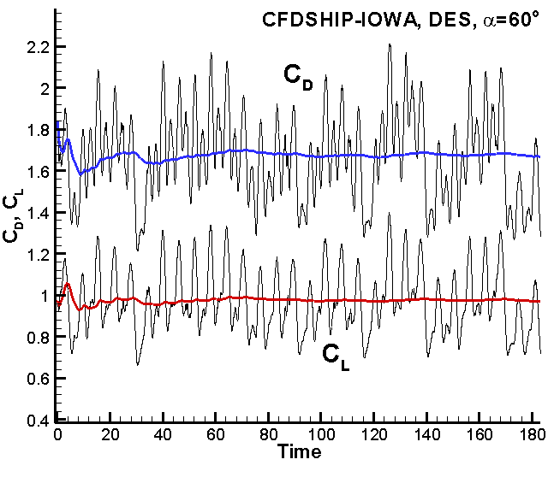
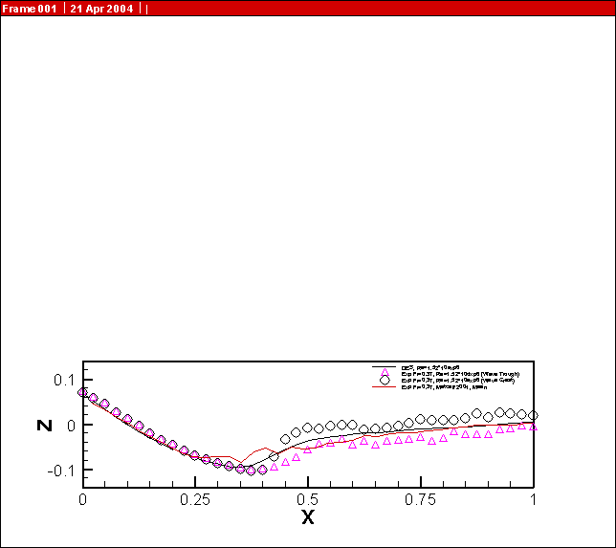
Post-Processing (visualization, XY plots)
Lift and drag coefficients of
NACA12 with 60º angle of attack
(CFDSHIP-IOWA, DES)
Wave profile of surface-piercing
NACA24, Re=1.52e6, Fr=0.37
(CFDSHIP-IOWA, DES)

Slide 22
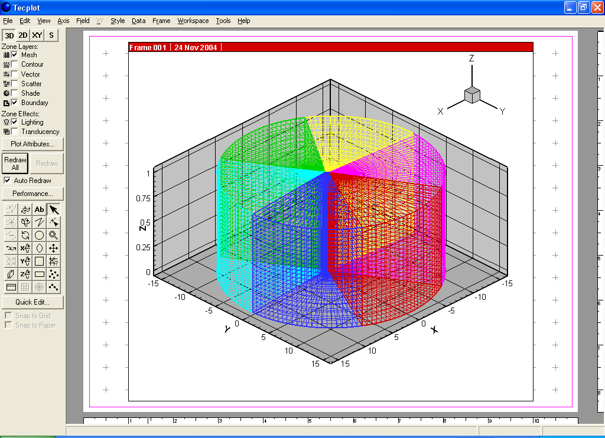
Post-Processing (visualization, Tecplot)
Different colors illustrate different blocks (6)
Re=10^5, DES, NACA12 with angle of attack 60 degrees

Slide 23
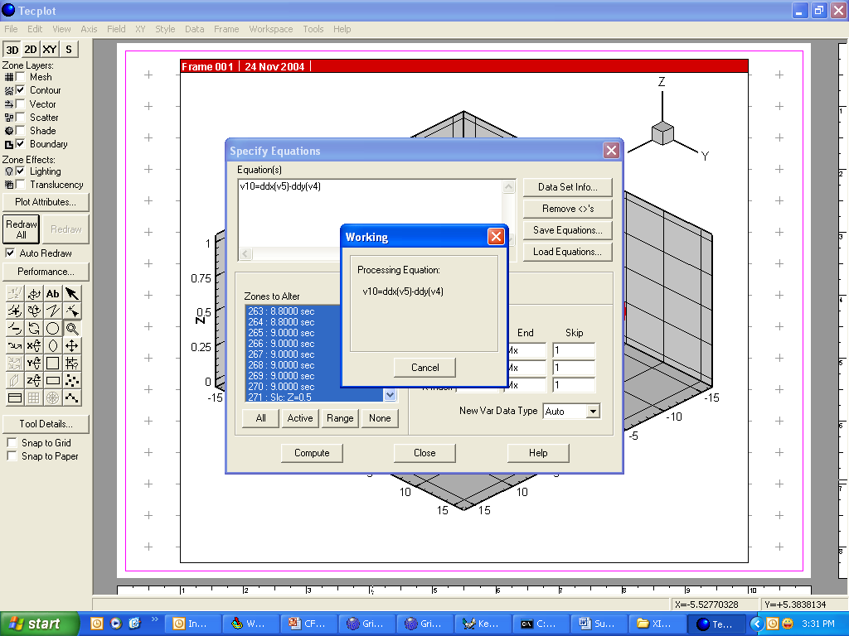
Post-Processing (NACA12, 2D contour plots, vorticity)
Define and compute new variable: “Data”→”Alter”→”Specify equations”→”vorticity in x,y plane: v10”→”compute”→”OK”.

Slide 24
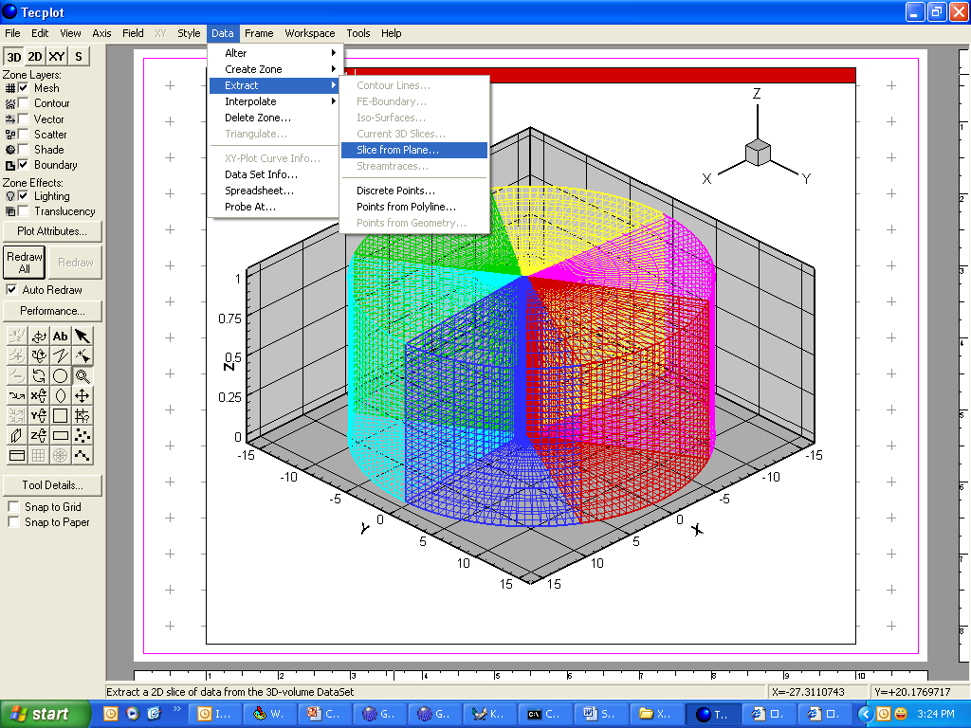
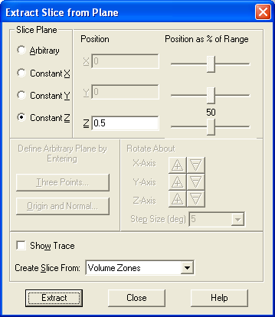
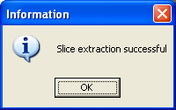
Post-Processing (NACA12, 2D contour plot)
Extract 2D slice from 3D geometry: “Data”→”Extract”→”Slice from plane”→”z=0.5”→”extract”

Slide 25
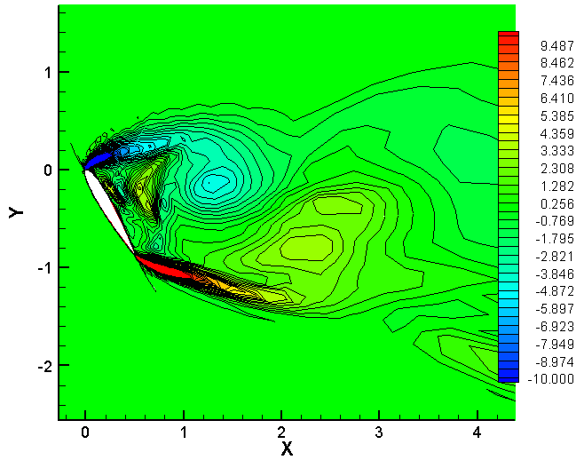
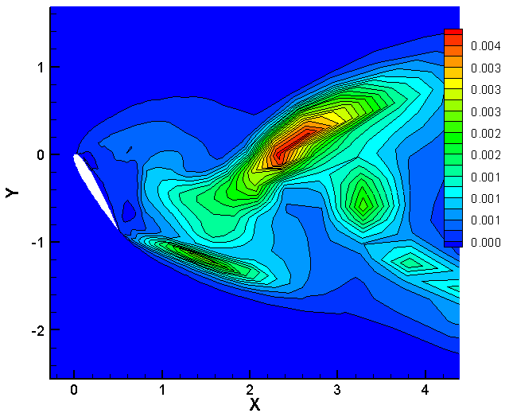
Post-Processing (NACA12, 2D contour plots)
2D contour plots on z=0.5 plane (vorticity and eddy viscosity)
Vorticity ω_{z}
Eddy viscosity

Slide 26
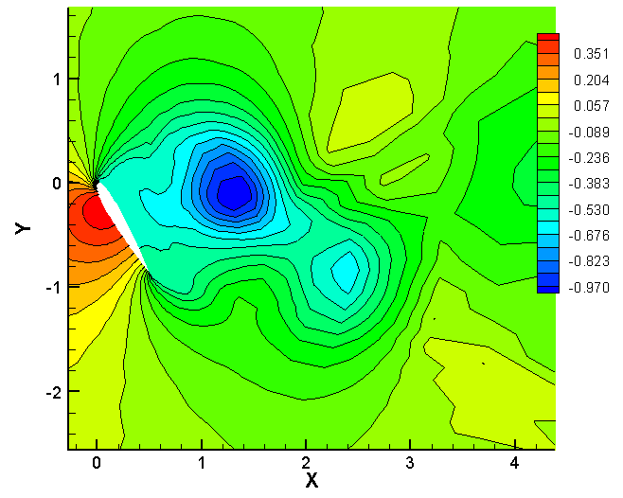
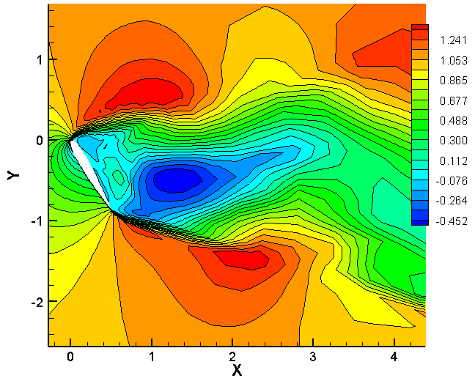
Post-Processing (NACA12, 2D contour plots)
2D contour plots on z=0.5 plane (pressure and streamwise velocity)
Pressure
Streamwise velocity

Slide 27
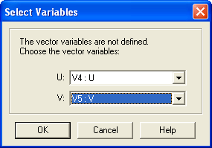
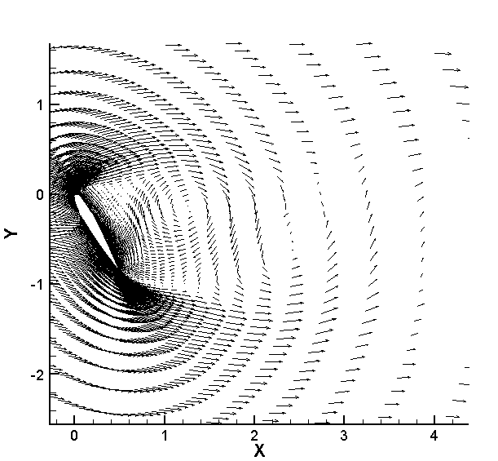
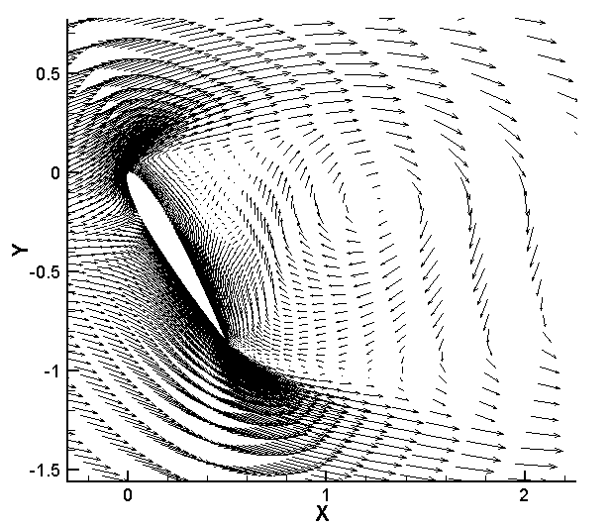
Post-Processing (2D velocity vectors)
2D velocity vectors on z=0.5 plane: turn off “contour” and activate “vector”, specify the vector variables.
Zoom in

Slide 28
Post-Processing (3D Iso-surface plots, cont’d)
3D Iso-surface plots: pressure, p=constant
3D Iso-surface plots: vorticity magnitude
3D Iso-surface plots: λ₂ criterion
Second eigenvalue of
3D Iso-surface plots: Q criterion (positive 2nd invariant of Jacobian)
(Q > 0 implies local pressure smaller than surrounding pressure)

Slide 29
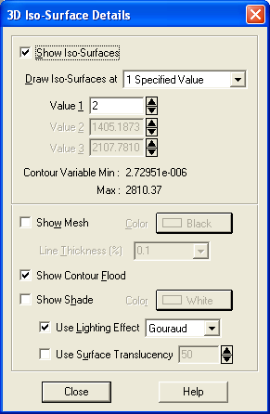
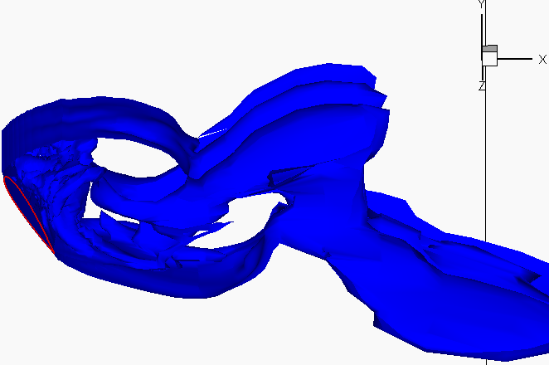
Post-Processing (3D Iso-surface plots)
3D Iso-surface plots: used to define the coherent vortical structures, including pressure, voriticity magnitude, Q criterion, λ_{2,} etc.
Iso-surface of vorticity magnitude

Slide 30
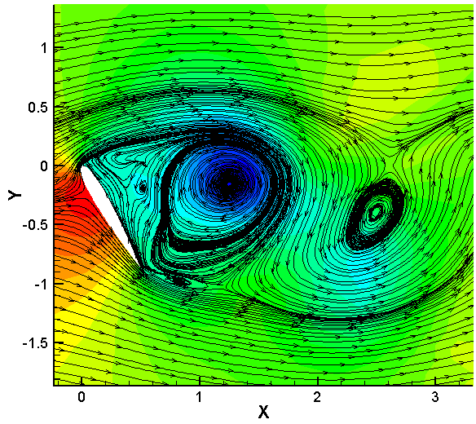
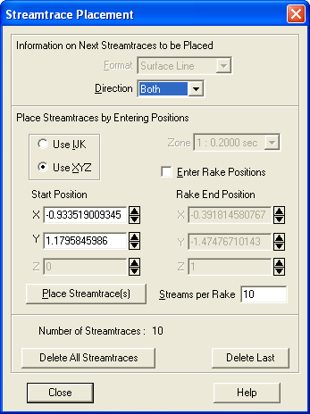
Post-Processing (streamlines)
Streamlines (2D):
Streamlines with contour of pressure
Streaklines and pathlines (not shown here)

Slide 31
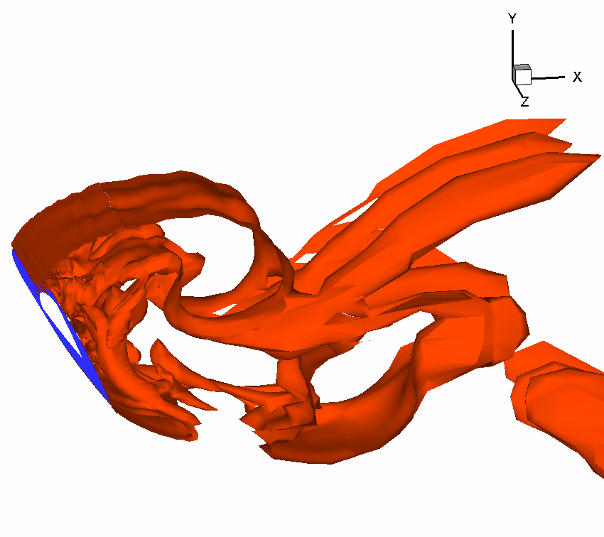
Post-Processing (Animations)
Animations (3D): animations can be created by saving CFD solutions with or without skipping certain number of time steps and playing the saved frames in a continuous sequence.
Animations are important tools to study time-dependent developments of vortical/turbulent structures and their interactions
Q=0.4

Slide 32
Other Post-Processing techniques
Fast Fourier Transform
1. A signal can be viewed from two different standpoints: the time domain and the frequency domain
2. The time domain is the trace on an signal (forces, velocity, pressure, etc.) where the vertical deflection is the signals amplitude, and the horizontal deflection is the time variable
3. The frequency domain is like the trace on a spectrum analyzer, where the deflection is the frequency variable and the vertical deflection is the signals amplitude at that frequency.
4. We can go between the above two domains using (Fast) Fourier Transform
Phase averaging (next two slides)

Slide 33
Other Post-Processing techniques (cont’d)
Phase averaging
− Assumption: the signal should have a coherent dominant frequency.
− Steps:
1. a filter is first used to smooth the data and remove the high
frequency noise that can cause errors in determining the peaks.
2. once the number of peaks determined, zero phase value
is assigned at each maximum value.
3. Phase averaging is implemented using the triple decomposition.
mean component
organized oscillating component
random fluctuating component
is the time period of the dominant frequency
is the phase average associated with the coherent structures

Slide 34
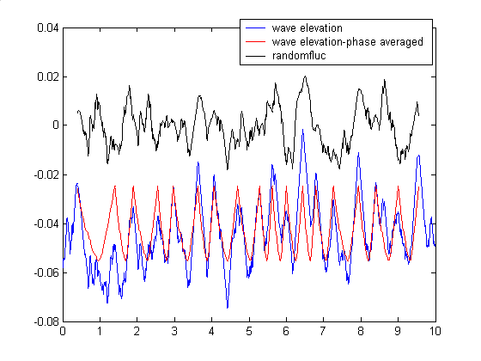
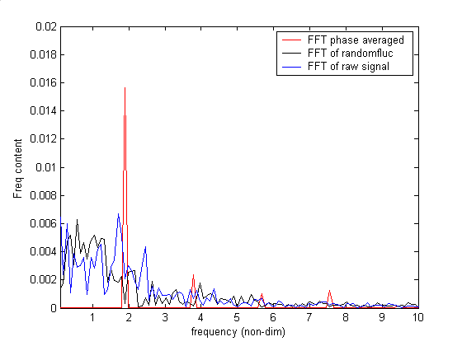
Other Post-Processing techniques (cont’d)
FFT and Phase averaging (example)
Original, phase averaged, and random fluctuations of the wave elevation at one point
FFT of wave elevation time histories at one point

Slide 35
References and books
User Manual for GridGen
User Manual for Tecplot
Numerical recipes:
http://www.nr.com/oldverswitcher.html
Sung J. & Yoo J. Y., “Three Dimensional Phase Averaging of Time Resolved PIV measurement data”, Measurement of Science and Technology, Volume 12, 2001, pp. 655-662.
Joe D. Hoffman, “Numerical Methods for Engineers and Scientists”, McGraw-Hill, Inc. 1992.
Y. Dubief and F. Delcayre, “On Coherent-vortex Identification in Turbulence”, Journal of Turbulence, Vol. 1, 2000, pp. 1-20.

